Slide 1
Pipes in Angular
use for Filter the data

Slide 2
Definition
Pipes are reffered as filters. I helps to transform data and manage data and manage data within Interpolation.
In a simple way
Pipes are used with a Pipe (|) character, it takes an input and returns a desired formatted output.
INPUT
PIPE
OUTPUT

Slide 3
Interpolation
Text interpolation allows you to incorporate dynamic string values into
your HTML templates.
{{ }}
Also known as one way data binding

Slide 4
Types of Pipe
Built-in Pipes
These pipes are pre defined.Here Is some built-in pipes
DatePipe,CurrencyPipe,AsyncPipe,DecimalPipe,JsonPipe,TitleCasePipe,UpperCaseIpipe,LowerCasePipe,KeyValuePipe,PercentPipe
Custom Pipe
There is a number of Built-in Pipes available, sometimes we may want to transform values in custom formats. Let's check how we can create our own Pipes in Angular application.

Slide 5
Example of BUILT-IN PIPE

Slide 6
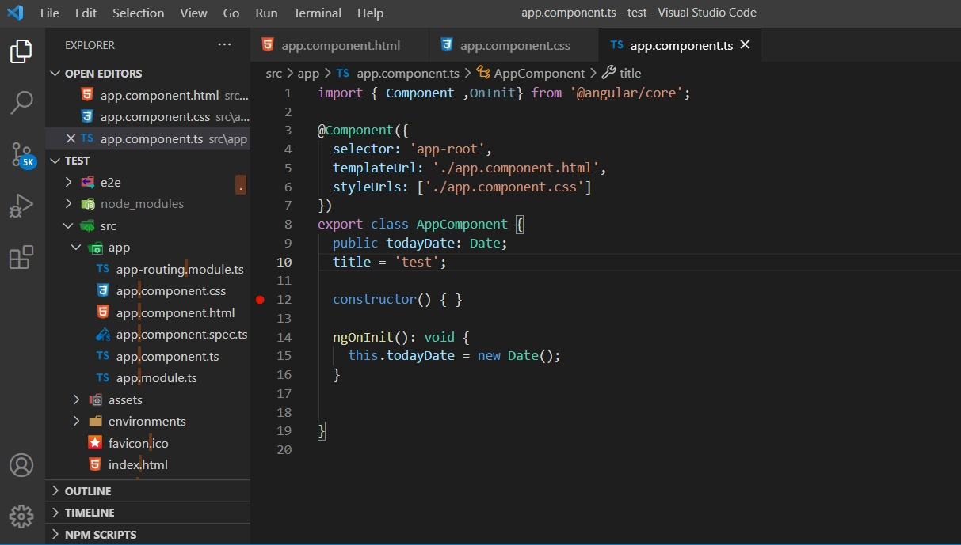
First See what happen when we did not use any Pipe here we try to show date in our website.this is app.comp.ts

Slide 7
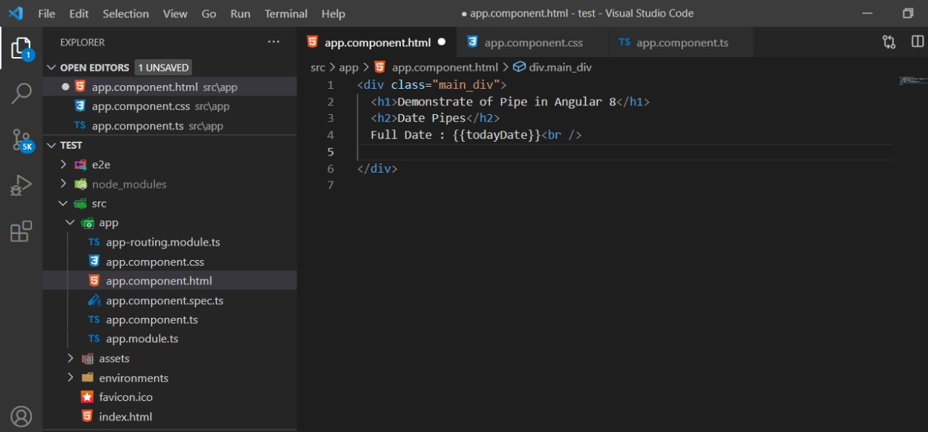
This is html file and here we use interpolation to get the date lets see the output without using date pipe.

Slide 8
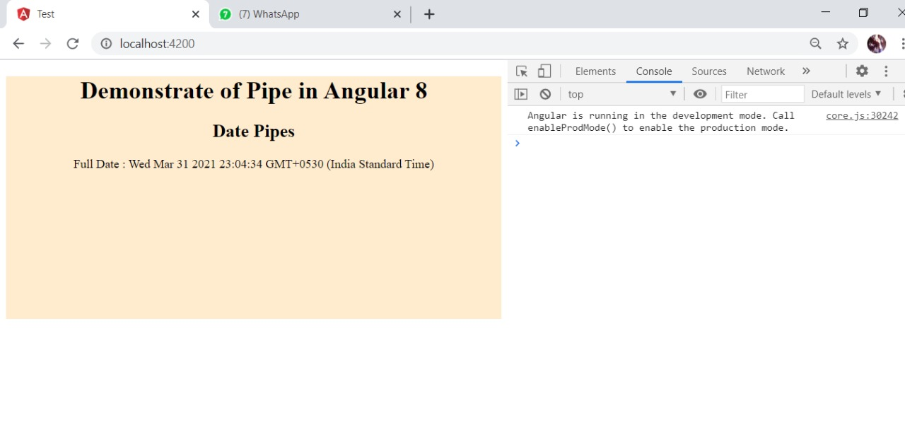
See we can get the date but this is not so much understandable lets add date pipe to make it more readable

Slide 9
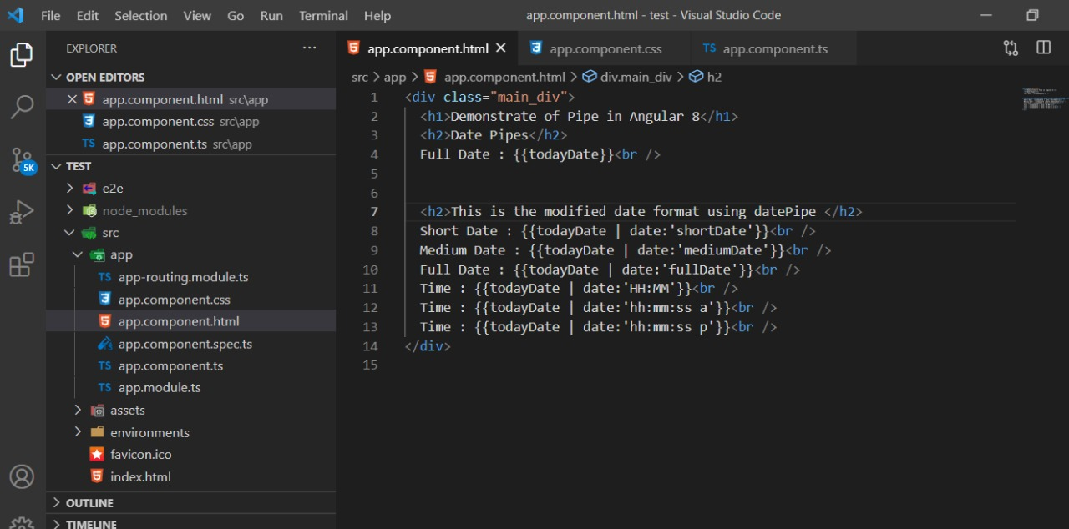
here you can see the date Pipe {{todayDate | date}} or we can add some parameters to modify the date format {{todayDate | date:’shortDate’}} let’s see the output

Slide 10
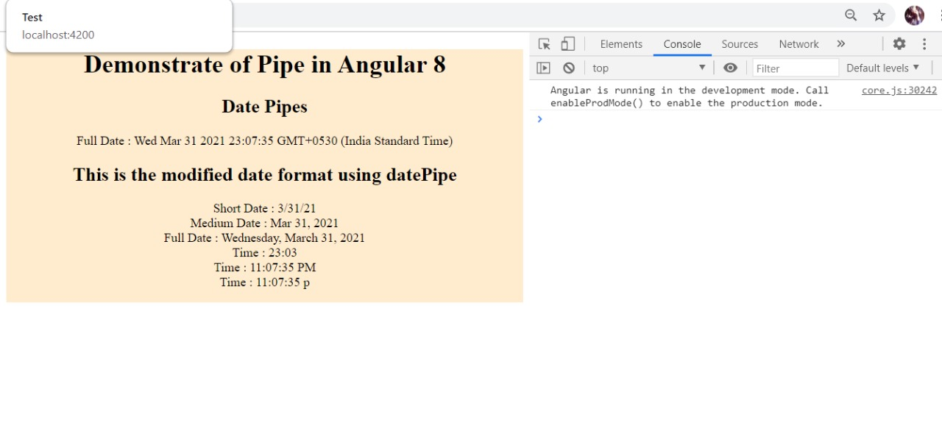
now you can compare both output and see the difference

Slide 11
CUSTOM PIPE
sometimes we may want to transform values in custom formats.
lets see how we can create a custome pipe

Slide 12
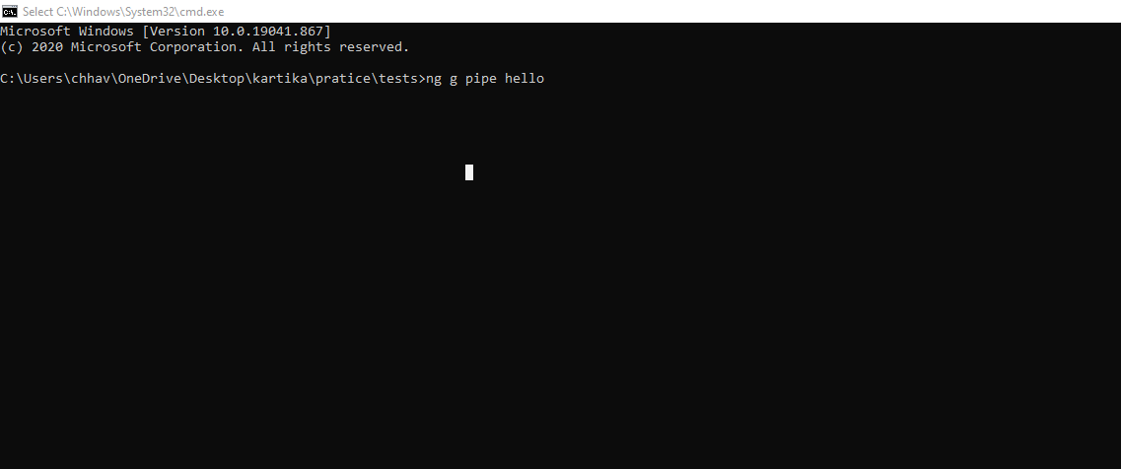
run this cmd “ng g pipe hello” in your project dir

Slide 13
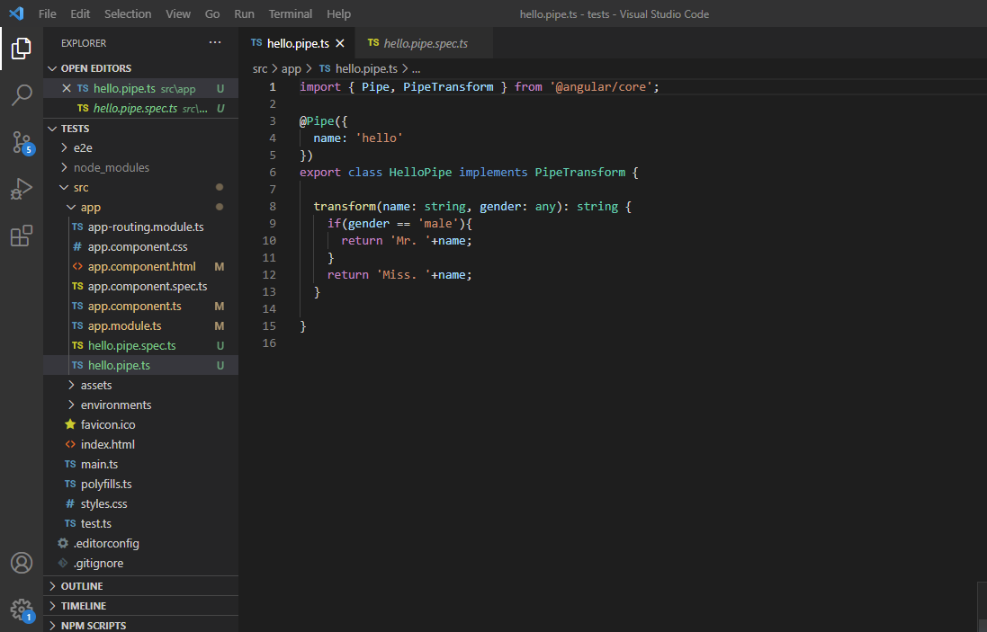
that cmd create two files .ts and .spec.ts here we need to modify only .ts file.

Slide 14
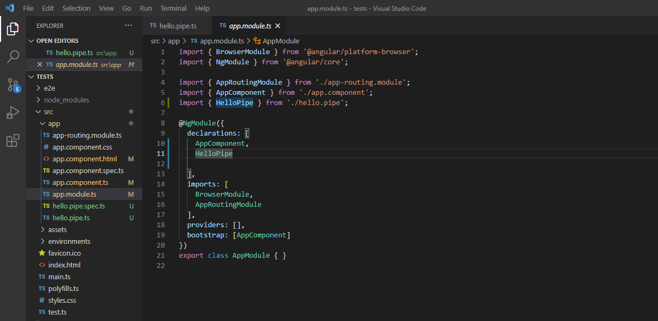
this is app.module.ts whenever you generate a pipe that pipe will import here

Slide 15
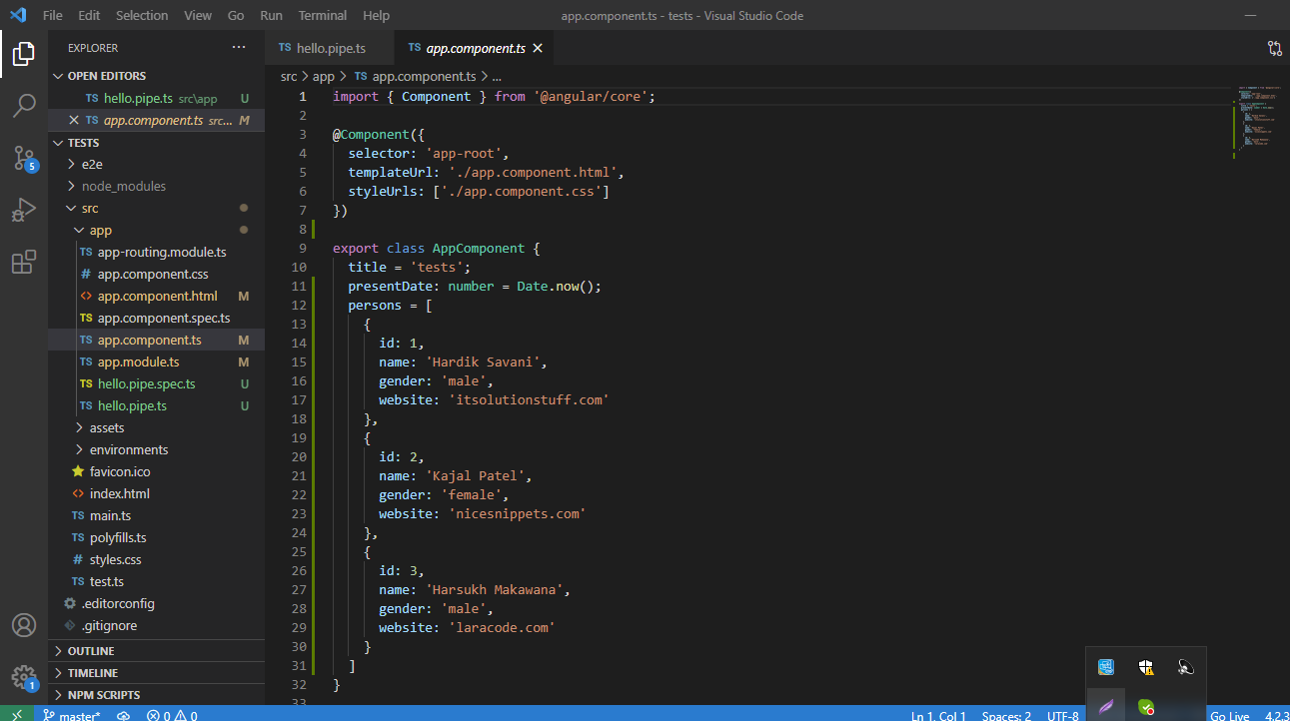
this is app component .ts here we are creating a data array of persons

Slide 16
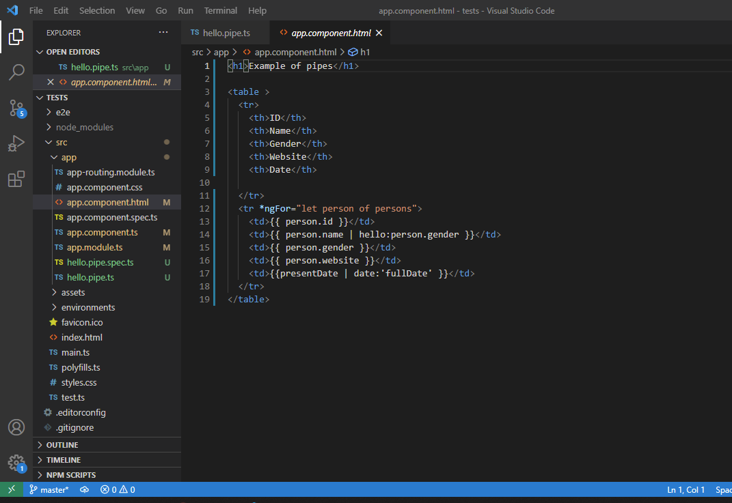
this is the final html file here we are getting the data through *ngFor

Slide 17
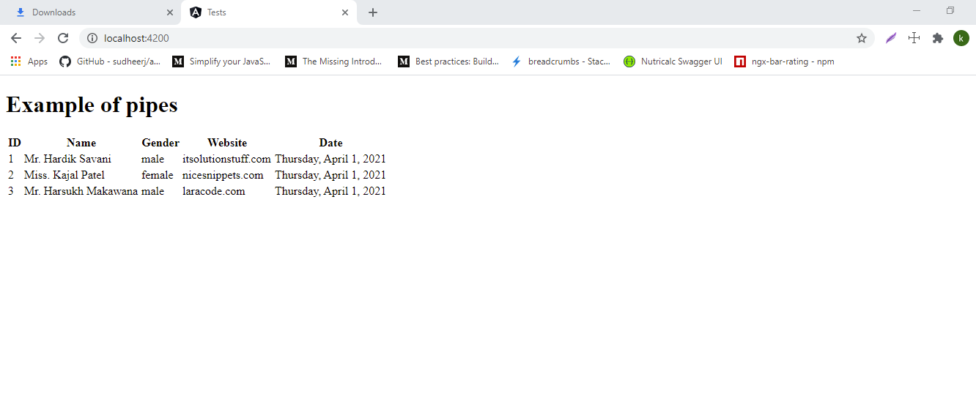
Final output . This is how a custom pipe work

Slide 18
THANK YOU FOR WATCHING
... KARTIKA

